Slide 1
Decision Tree Outlier Regressor to Explain Anomalies
Authors: Riccardo Crupi, Daniele Regoli, et al.
Presenter’s name: Mohammad Haghighat Teaching assistant: Hossein Fanaei Course: Advanced Data Mining
12 June 2025

Slide 2
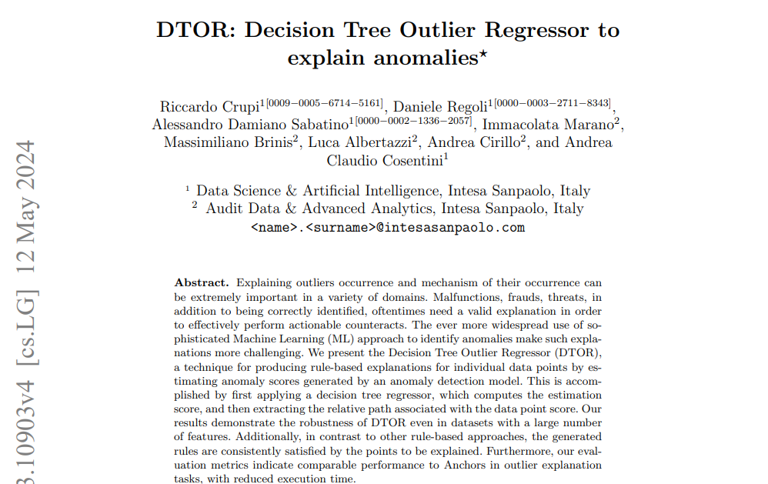

Slide 3
CONTENTS OF THIS PAPER
There’s what you’ll find in this presentation:
The Gap in Existing XAI Solutions
DTOR: Using a Simple Model to Explain a Complex One
The "Magic" Behind DTOR: The Weighted Loss Function
Experiments
Evaluation Metrics
Results: DTOR vs. Anchors
The Black Box Problem in Anomaly Detection

Slide 4
The Black Box Problem in Anomaly Detection
01

Slide 5
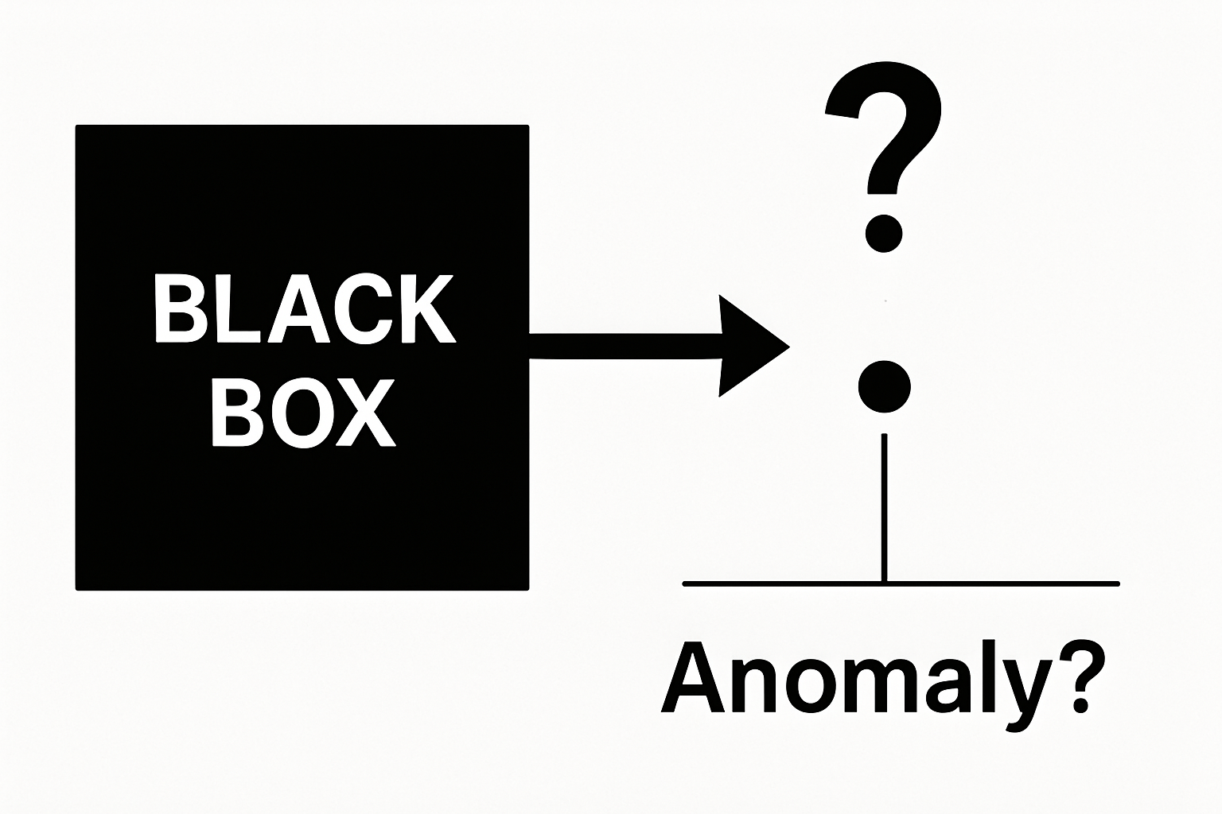
The Black Box Problem in Anomaly Detection

Slide 6
The Black Box Problem in Anomaly Detection
Anomaly detection is crucial in fields like banking (fraud detection), manufacturing (malfunctions), and cybersecurity (threats).
Identifying an anomaly is not enough. We need to understand the reason to take effective action.
Modern anomaly detection models (e.g., Deep Learning, Ensembles) are often "black boxes," making them hard to interpret.

Slide 7
The Gap in Existing XAI Solutions
02

Slide 8
The Gap in Existing XAI Solutions
Feature Importance Methods (e.g., SHAP, DIFFI):
Pros: Tell us which features are important.
Cons: Don't provide the logic or the "if-then" conditions. Hard to interpret with many features.
Rule-Based Methods (e.g., Anchors):
Pros: Provide human-readable "if-then" rules.
Cons: Not designed for regression tasks, like explaining a continuous anomaly score. They are built for classification.

Slide 9
DTOR: Using a Simple Model to Explain a Complex One
03

Slide 10
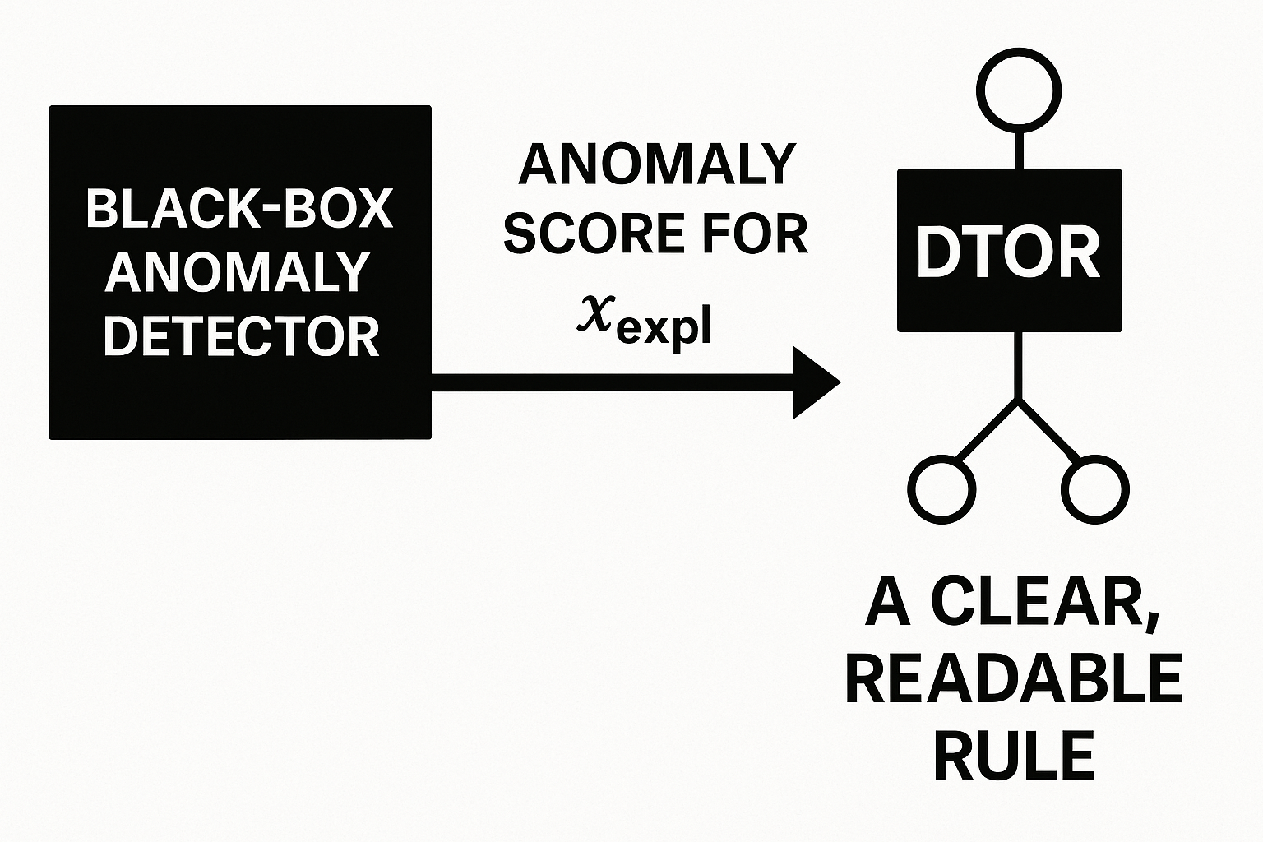
DTOR: Using a Simple Model to Explain a Complex One

Slide 11
DTOR: Using a Simple Model to Explain a Complex One
Core Idea: Train a simple, interpretable model (Decision Tree Regressor) to mimic the behavior of the complex, black-box anomaly detection model, but only for the specific instance we want to explain.
Key Inspiration: Inspired by Isolation Forest—the idea that anomalies are "easier to isolate" with fewer rules.

Slide 12
The "Magic" Behind DTOR: The Weighted Loss Function
04

Slide 13
The "Magic" Behind DTOR: The Weighted Loss Function
Input: The instance to explain (x_expl), its anomaly score, and the training data with their scores.
Key Step: When training the Decision Tree, assign a very high weight (β) to x_expl and a low weight (e.g., 1) to all other data points.
Result: The Decision Tree is forced to create splits (rules) that perfectly isolate and predict the score for x_expl.
Output: The path taken by x_expl from the root to a leaf in the tree is the explanation rule.

Slide 14
Experiments
05

Slide 15
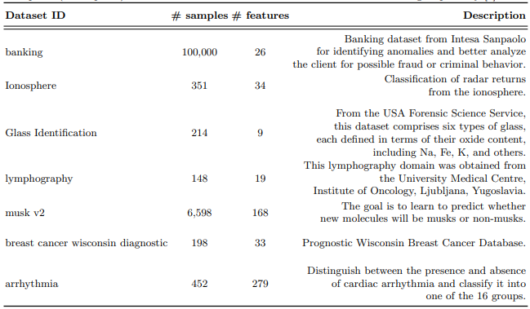
Datasets

Slide 16
Anomaly Detection Models
Isolation Forest (IF)
One-Class SVM
Gaussian Mixture Models (GMM)
This ensures DTOR is truly model-agnostic

Slide 17
Evaluation Metrics
06

Slide 18
Evaluation Metrics
Precision
Coverage
Validity
Rule Length
Execution Time

Slide 19
Results: DTOR vs. Anchors
07

Slide 20
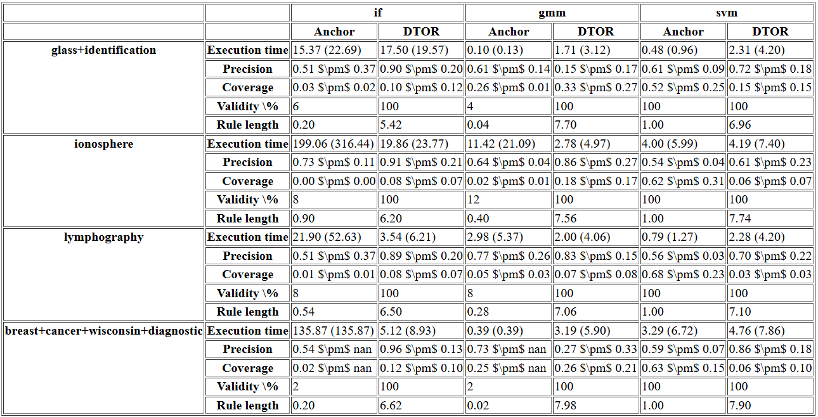
My results

Slide 21
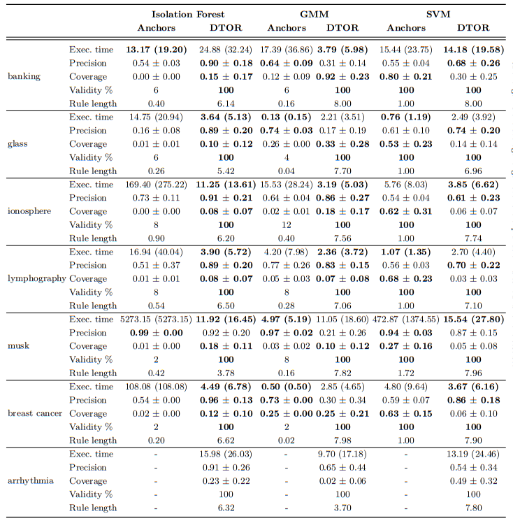
Paper results

Slide 22
Thanks

